Slide 1

Assignment 3: The Professional Development Reflection
INF20028: Professional Capabilities for a Digital World
S M Ragib Rezwan (103172423)
Notes:
Hi everyone! During the unit there has been several topics that had made me self reflect. Here, I would be going through 2 of them in details, utilizing Gibbs reflective cycle, in order to not only self reflect but also determine possible future plans for improvement.

Slide 2
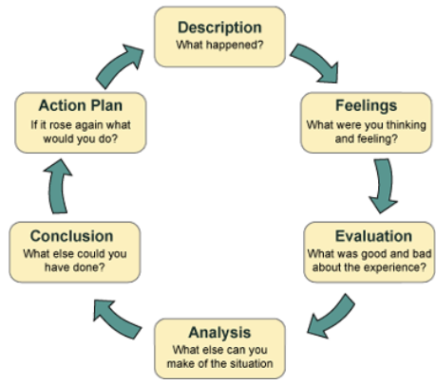
Gibbs Reflective Cycle
Notes:
But what is gibbs cycle? It basically an in-depth analysis of experience in the following steps: description, feelings, experience, evaluation, analysis, conclusion and action plan

Slide 3
Privacy by Design
Built into design and architecture of :
Information systems,
business processes
And networked infrastructure (Sargent, J. & McLoughlin, S. 2023, sl.11)
Notes:
First topic that I want to reflect on is Privacy, expecially Privacy by design(PbD). It's basically a methodology by Dr Ann Cavoukian which states that privacy should be "built into the design and architecture of the information system, business practises and networked infrastructures (lect 4.2).

Slide 4



Ann Cavoukian
She was:
The former IPC (Information and Privacy Commissioner) of Ontario (Wikipedia, 2023)
Distinguished visiting professor at Toronto Metropolitan University (Ryerson University).(Wikipedia, 2023)
The world's leading privacy expert (Toronto Metropolitan University, 2018)
PbD (Privacy by Design) implemented by:
Notes:
This made me look up details about her which showed that she was:
the former IPC of Ontario
a distinguished visiting professor at Toronto Metropolitan University (Ryerson University)
the world's leading privacy expert
And that her methodlogy has also been implemented in various like Deloitte, Ethyca, Aus govt, etc.

Slide 5
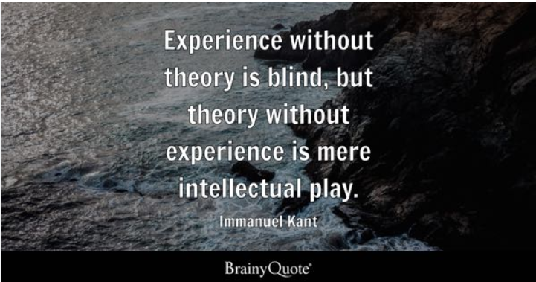
Notes:
When I first read about it, I thought it was just an "intellectual play" that wont work in reality and thus was quite surprised to see it being considered as an extremely important aspect in data management worldwide.

Slide 6


Notes:
Hence the incident made me realize the difference in my and Ann's perception of privacy, leading me to think deeper about privacy itself. Since my childhood, I have been always been told that "only those who do bad things will keep their doors locked and hide away". So, if I am doing good things, I dont need to hide anything away and instead should keep everything open for everyone to see.
Furthermore, I had also noticed the amount of personal data that were being collected by online organizations on a daily basis and had believed that the only way to go private was to give up everything and live off the grid.
But according to Ann, "privacy is the essense of freedom" and is not impacted by what that person does in private. Furthermore, by following her privacy by design methodology, people can continue existing online, without having any conflict with their privacy!
This made me realise that, I (alongside my family and peers back home) had basically been misguided about the true meaning of privacy all this time and instead had been encouraged to not care about it being violated!

Slide 7
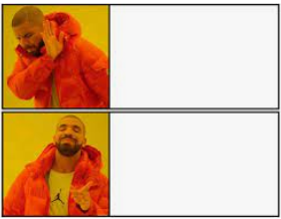
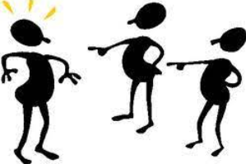
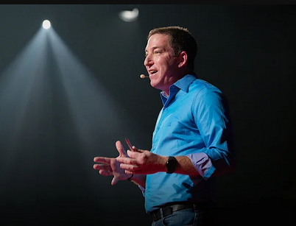

Judging without knowing about topic
Glenn Greenwald: Why privacy matters
Notes:
Overall, I have realised that I shouldnt actually judge a topic or concept without fully understanding what it is. Furthermore, I had also realised that the environment where I had been before had been proactively encouraging people to let go of thier privacy, even though its a fundamental human right! And that this needs to change!
Hence, I will first take steps to properly understand privacy and its importance by watching videos and reading articles on it. After this, I would go through and understand privacy by design, focusing on the way it is implemented in industries here and abroad. Then I will spread those information in a clear and simple manner with my family, peers, collegues in my workplace, etc. Thus, over time, through Diffusion of Innovations theory, it would not only be known to everyone back in my home country, but would also be actively followed by them! Hence, slowly, but surely, it will result in a full shift in both mine and the people's mindset, making everyone aware on how important privacy is and ensure that organizations properly respect it when handling our data

Slide 8
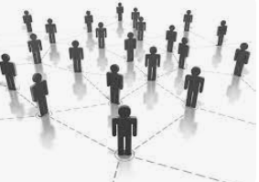
Social Capital
Putnam:
The connections among individuals—social networks and the norms of reciprocity and trustworthiness that arise from them(Sargent, J. & McLoughlin, S. 2023, sl.8)
What’s the big deal?
Notes:
After this, I have also reflected on the concept of "Social Capital" which is best explained by Putnam's words of "connections among individuals - social networks and norms of reciprocity and trustworthiness that arises from them“. I noticed this happening between people in various events as a part of "networking"
So, when I first read that, I felt weirded out. After all, its basically just people socializing right, so what’s the big deal?

Slide 9
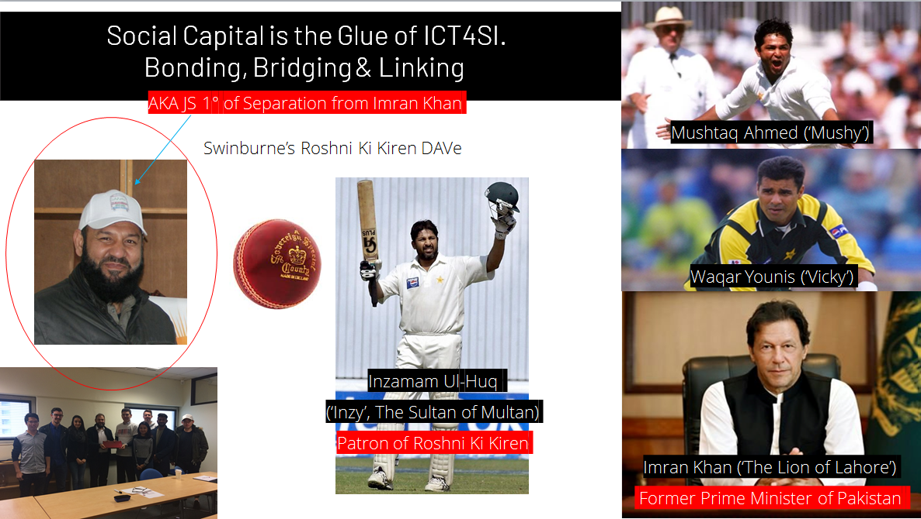
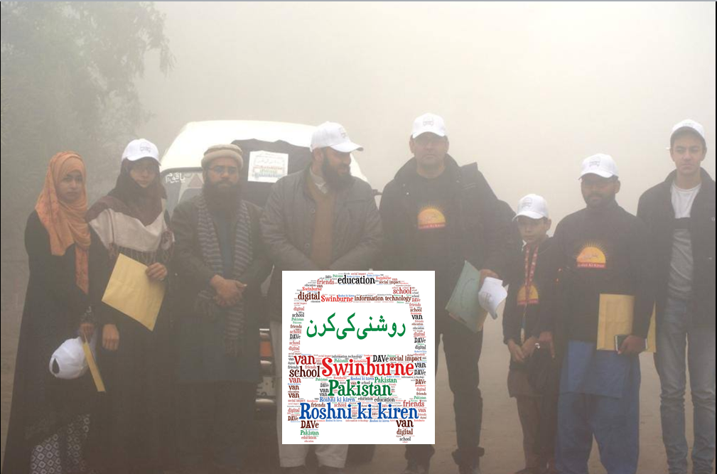
Visible Outcomes of the conversations
Invisible Outcomes of the conversations
Exchange of LinkedIn details
Bond Formation
Exchange of Hidden Information
Oppurtunity
Notes:
So, I decided to think back and evaluate the situation, focusing on the actions and outcome of those people. There I noticed that most of the people would engage themselves in various conversations and gossips. Furthermore, these conversations would not only result in exchange of linkedIn information for future contact, but would also bring up information that still wasn't public (like hidden bugs in a product, potential job openings, etc).
Basically, through these seemingly simple conversations amongst individuals, not only were there bonds being created, but also the fact that hidden information were being exchanged which created opportunities for the people like allowing them to tap onto the hidden job market, set up future teams, etc.
This also reminded me about the slide about Dr. Faryal Younis that was shown in class, whose social capital was utilized by Swinburne's Roshni ki Kiren DAVe project achieve thier goal.

Slide 10
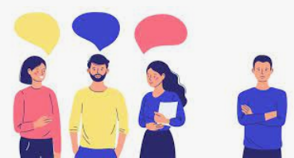
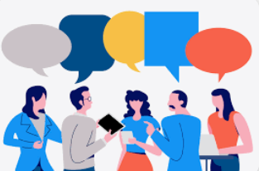
Notes:
All of these made me reflect on my usual antisocial behavior (especially in front of strangers in events) and realise that it was actually causing me to miss out on various oppurtunities to meet and connect with people. So I need to start building my social capital as soon as possible!
Hence, from now on, I would need to further develop my social skills by not only attending more events but also actively participating and engaging in them. This would be done by joining in the open conversations the people would have, providing my own thoughts about the topic at hand, and engaging myself in them. This would build up trust and empathy between me and my fellow professionals and hence lead to the creation of the social capital that I could be proud of

Slide 11
Reference:
BrainyQuote. (n.d.). Immanuel Kant Quotes. BrainyQuote. Retrieved May 27, 2023, from https://www.brainyquote.com/quotes/immanuel_kant_121324
Chan, K. (2023, January 4). European Union fines Facebook parent Meta 390M euros for privacy violations. PBS NewsHour. https://www.pbs.org/newshour/world/european-union-fines-facebook-parent-meta-390m-euros-for-privacy-violations
Crowe Associates Ltd. (2019). Gibbs Reflective cycle | Crowe Associates. Crowe-Associates.co.uk. https://www.crowe-associates.co.uk/coaching-tools/gibbs-reflective-cycle/
Ethyca. (n.d.). Privacy by Design | Ethyca. Data Privacy Software & CCPA Compliance Software | Ethyca. Retrieved May 27, 2023, from https://ethyca.com/about-privacy-by-design
Halton, C. (2021, November 21). Diffusion Of Innovations Theory Definition. Investopedia. https://www.investopedia.com/terms/d/diffusion-of-innovations-theory.asp
Kingsmill, S., Cavoukian, A., Deloitte, & Toronto Metropolitan University. (n.d.). Privacy by Design Setting a new standard for privacy certification. https://www2.deloitte.com/content/dam/Deloitte/ca/Documents/risk/ca-en-ers-privacy-by-design-brochure.PDF
OAIC. (2023a, March 10). Privacy by design. OAIC. https://www.oaic.gov.au/privacy/privacy-guidance-for-organisations-and-government-agencies/privacy-impact-assessments/privacy-by-design
OAIC. (2023b, March 10). What is privacy? OAIC. https://www.oaic.gov.au/privacy/your-privacy-rights/your-personal-information/what-is-privacy
Practice. (2022, September 12). Top 5 Benefits of Developing Communication Skills | Practice. Practice.do. https://practice.do/blog/benefits-of-communication-skills
Sargent, J. & McLoughlin, S. (2023, Mar 8). Privacy. [PowerPoint Slide] Canvas@Swinburne University. https://swinburne.instructure.com/
Sargent, J. & McLoughlin, S. (2023, Mar 8). Professional Belonging Social Capital Communities of Practice (CoPs) Module Sense-making Classroom . [PowerPoint Slide] Canvas@Swinburne University. https://swinburne.instructure.com/
Sargent, J. & McLoughlin, S. (2023, Mar 8). Social Capital: Presentation 1. [PowerPoint Slide] Canvas@Swinburne University. https://swinburne.instructure.com/
Toronto Metropolitan University. (2018, August 30). Ann Cavoukian. Toronto Metropolitan University. https://www.torontomu.ca/pbdce/about/ann-cavoukian/
Wikipedia. (2023, April 4). Ann Cavoukian. Wikipedia. https://en.wikipedia.org/wiki/Ann_Cavoukian
Youtube - TED. (2014, October 11). Glenn Greenwald: Why privacy matters. Www.youtube.com. https://www.youtube.com/watch?v=pcSlowAhvUk&pp=ygUTdGVkIHRhbGsgb24gcHJpdmFjeQ%3D%3D

